Slide 1


FOOTBALL GLOBAL TRANSFER MARKET ANALYSIS (2000-2021)

Slide 2


Project Overview
This analysis utilizes a dataset of major football transfers from 2000 to 2021, focusing on fees, player demographics, and market movements.
Objectives
Transform raw transfer and birth years into key metrics like Transfer Age and Fee (Raw Euros).
Determine which player positions command the highest average fees and volume of spending.
Analyze the flow of capital by identifying key buying and selling countries.
Use Goal Seek and What-If Analysis to set acquisition benchmarks for future transfers.
Consolidate all findings into a dynamic, user-friendly Dashboard.

Slide 3
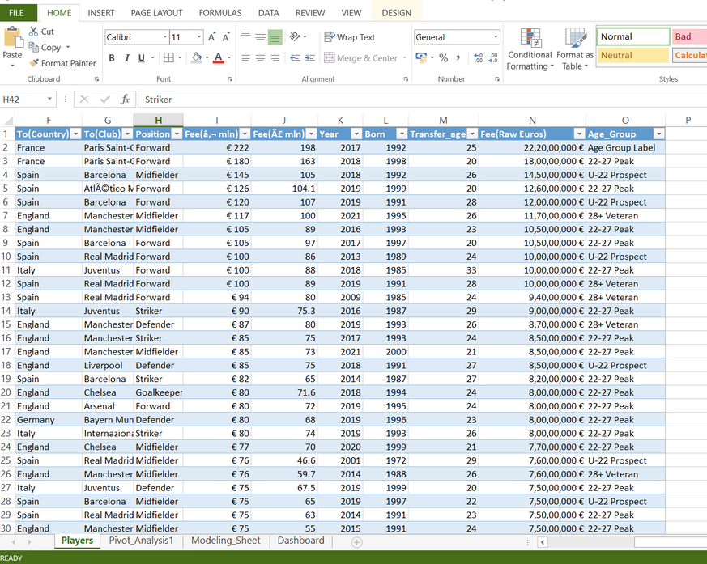
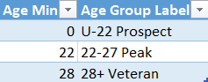
Data Analysis and use of Formulas
We used Excel formulas to make raw data better and ready for deeper analysis. This helps turn basic data into useful insights.
Key Data Transformations Formulas
Transfer Age
=[Year] - [Born]
Determines the player's age at the time of transfer..
Fee (Raw Euros)
=[Fee(€ mln)] * 1,000,000
Converts the fee standard currency value.
Age Group
=VLOOKUP(M54,Table2[#All],2,TRUE)
Creates three distinct market segments on age group using lookup table.
Insights
Total Market Sum: The aggregate value of all analyzed transfers, calculated using the SUM function on the Fee (Raw Euros) column.

Slide 4
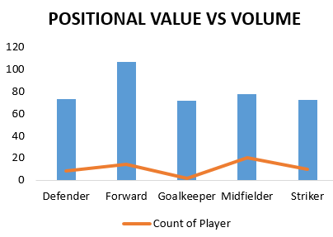
Pivot Tables & Charts
Pivot Tables were used to aggregate transfer data by position, age, and country, providing initial insights into market trends.
1.Positional Value Analysis Table
Rows: Position (Forward, Midfielder, etc.)
Values: Average of Fee (€ mln) and Count of Players
Insight: The analysis confirmed that Forwards and Midfielders command the highest average transfer fees, while Defenders show the highest transaction volume
2.Market Flow Analysis Charts
Chart A: Top Buying Countries: A Bar Chart showing the Sum of Fee (Raw Euros) by To(Country)
Chart B: Market Inflation: A Line Chart plotting the Average of Fee (€ mln) against the Year of transfer.
Findings: Identifies countries (and corresponding leagues) with the highest net transfer spending.
Clearly illustrates market fee inflation, especially a dramatic rise post-2016.

Slide 5
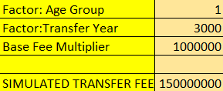
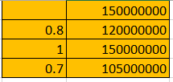
Strategic Modeling: What-If Analysis and Goal Seek
We used Excel's What-If tools to create predictive, forward-looking scenarios based on a simplified valuation model.
Model Assumption
Simulated Fee = Age Group Factor*Transfer Year Factor *Base Fee Multiplier* 0.05
1. Goal Seek: Setting Fee Targets
Objective: Determine the minimum Transfer Year Factor required for a player to reach a target fee of €150 million.
Set Cell: Simulated Fee Cell
Value: 150,000,000
By Changing Cell: Transfer Year Factor
0.05 - arbitory factor
Insight: This establishes a concrete market benchmark—a "minimum required year" to justify a high-end acquisition fee.
2.What-If Analysis: Simulating Age Impact
Scenario: How does a player's Age Group affect their ultimate sale price?
Variables: The table models the Simulated Fee against a change in the Age Group Factor (e.g., U-22, 22-27, 28+).
Insight: Quantifies the financial penalty incurred when acquiring players outside their 22-27 Peak window, proving the optimal timing for transfers.

Slide 6
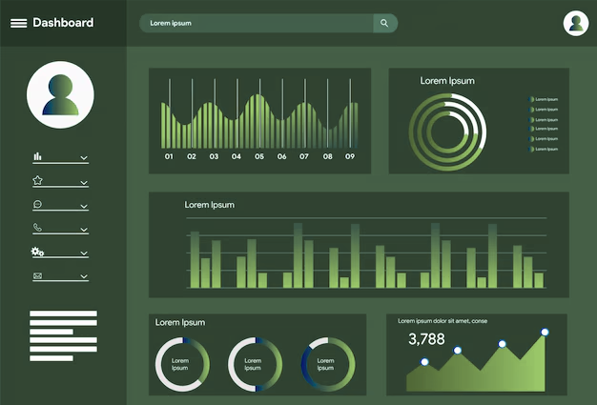
Interactive Dashboard and Strategic Conclusion
The final dashboard provides stakeholders with a single, interactive source of market truth, integrating all charts and filtering tools.
Strategic Conclusion
Risk vs. Value: Highest financial risk is justified for players in the 22-27 Peak Age Group.
Market Flow: A clear set of selling countries (talent exporters) provides the most viable targets for pipeline scouting.
Inflation Alert: The annual increase in average fees necessitates proactive recruitment to lock in value before costs rise further.

